Slide 1
A Look At DISA STIGs (3)
Windows Server 2012 R2 Member Server
Import STIG
V1099 (Lockout duration)

Slide 2
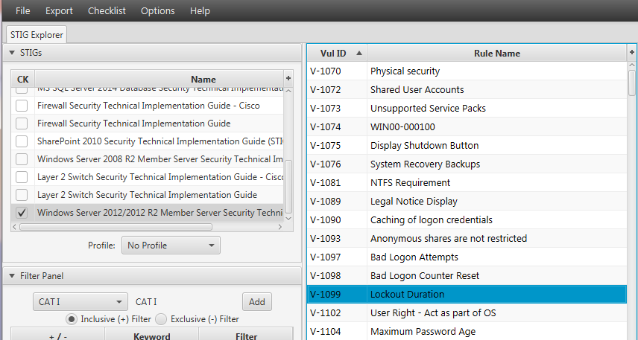
A Look At DISA STIGs (2)

Slide 3
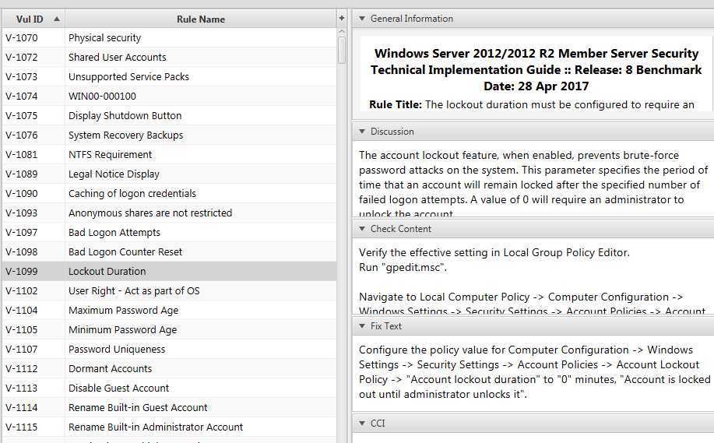
A Look At DISA STIGs (2)

Slide 4
A Look At DISA STIGs (3)
Rule Title:
The lockout duration must be configured to require an administrator to unlock an account
Severity: CAT II

Slide 5
A Look At DISA STIGs (3)
Discussion:
The account lockout feature, when enabled, prevents brute-force password attacks on the system. This parameter specifies the period of time that an account will remain locked after the specified number

Slide 6
A Look At DISA STIGs (3)
Discussion…:
of failed logon attempts. A value of 0 will require an administrator to unlock the account.

Slide 7
A Look At DISA STIGs (3)
Check Content:
Verify the effective setting in Local Group Policy Editor. Run "gpedit.msc".

Slide 8
A Look At DISA STIGs (3)
Check Content:
Navigate to Local Computer Policy -> Computer Configuration -> Windows Settings -> Security Settings -> Account Policies -> Account Lockout Policy.

Slide 9
A Look At DISA STIGs (3)
Check Content…:
If the "Account lockout duration" is not set to "0", requiring an administrator to unlock the account, this is a finding.

Slide 10
A Look At DISA STIGs (3)
Fix Text:
Configure the policy value for Computer Configuration -> Windows Settings -> Security Settings -> Account Policies -> Account Lockout Policy -> "Account lockout duration" to "0" minutes,

Slide 11
A Look At DISA STIGs (3)
Fix Text….:
"Account is locked out until administrator unlocks it".
CCI: NIST SP 800-53 Revision 4 :: AC-7 b
END

